Slide 1
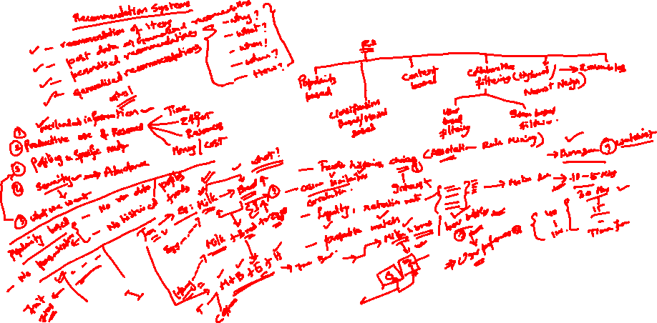

Slide 2
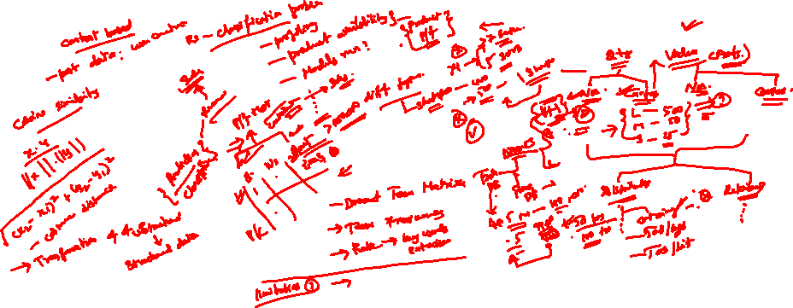

Slide 3
Content and Popularity based RecoSys

Slide 4
Learning Objectives
Introduction to recommendation system and its applications.
Why recommendation system is important.
Key approaches of Recommendation system.
Market basket analysis.
Content Based Recommendation system and its applications.
Case studies for Content based and Popularity based RecoSys.
4

Slide 5
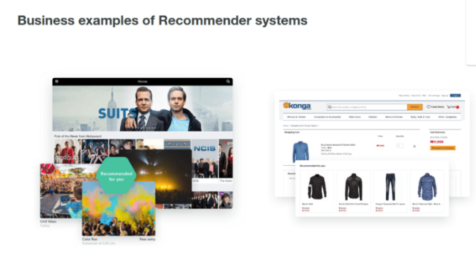
Introduction to recommendation system
and its applications
Recommender systems are one of the most successful and widespread application of machine learning technologies in business.
You can apply recommender systems in scenarios where many users interact with many items.

Slide 6
Intro to RecoSys Contd.
You can find large scale recommender systems in retail, video on demand, or music streaming.
Recommendation of news or videos for media, product recommendation or personalization in travel and retail can be handled by similar machine learning algorithms.
There are also recommender systems for experts, collaborators, jokes, restaurants, garments, financial services, life insurance, romantic partners (online dating), and Twitter pages.

Slide 7
Why recommendation system is important
Recommendation systems can help match users to items
They help item provider deliver their items to right user.
Identify products most relevant to the user.
Personalized content
Eg. Top and Offers
Help website improve user engagement and increase online sales

Slide 8
Key approaches of Recommendation system
The key approaches to RecSys
Collaborative filtering
Content based
Popularity based

Slide 9
Popularity based Recommendation system
Recommended items viewed/purchased by most people.
Recommendations : ranked list of items by their purchase count / viewed count “Popular news”.
It uses:
Text only
Purchase history
User and item features
Scale
Note: The problem with popularity based recommendation system is that the personalization is not available with this method . For eg: for a song recommendation if the model is popularity based recommender, it is not personalised towards any user and will output the same list of recommended songs

Slide 10
Content Based Recommendation system
and its applications
A content based recommender works with data that the user provides, either explicitly (rating) or implicitly (clicking on a link).
Based on that data, a user profile is generated, which is then used to make suggestions to the user.
As the user provides more inputs or takes actions on the recommendations, the engine becomes more and more accurate.
The information source that content-based filtering systems are mostly used with are text documents. A standard approach for term parsing selects single words from documents.

Slide 11
Content based RecoSys Contd.
Advantages
Content-based recommender systems do not use a lot of user data.
Only requires item data and you can start giving recommendations to users.
It is viable to give recommendations to even your first customer as long as you have sufficient data to build his user profile
Challenges
The item data needs to be well distributed
Recommendations to the user will be mostly substitutes, and not complements.
Less dynamic

Slide 12
Bag of Words (BOW) vectorization
Text data cannot be directly used for modelling.
One approach to extract features involves the BOW approach.
The BOW approach generates a Document-Term Matrix (DTM) where columns represents all the unique words in the corpus and the cell value indicates the frequency of that word in a given document.

Slide 13
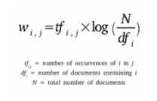
TF-IDF
TF-IDF is composed of 2 terms:
Term Frequency (TF) measures how frequently a term appears in the document.
Inverse Document Frequency (IDF) measures the relative importance of words in a corpus.

Slide 14
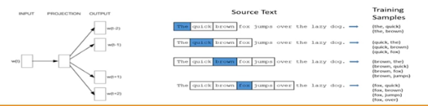
Word Embedding Models (Word2Vec)
Word vectors are trained by setting up a fake training task.
The weights of the hidden layer learnt during the training process provides the feature vector for each word – words that appear in similar context ends up having similar feature vectors.

Slide 15
Case Study
Anonymous Ratings from the Jester Online Joke Recommender System
Abstract
Ratings are real values ranging from -10.00 to +10.00 (the value "99" corresponds to "null" = "not rated").
One row per user
The first column gives the number of jokes rated by that user. The next 100 columns give the ratings for jokes 01 - 100.
Dataset
http://eigentaste.berkeley.edu/dataset/

Slide 16
Steps to follow
Read the dataset
Take care about the header as there are no column names given in the dataset.
Consider ratings named dataframe with only first 200 rows and all columns from 1(first column is 0) of dataset.
Change the column indices from 0 to 99
In the dataset, the null ratings are given as 99.00, so replace all 99.00s with 0
Normalize the ratings using StandardScaler and save them in ratings_diff variable
Find the mean for each column in ratings_diff i.e, for each joke
Consider all the mean ratings and find the jokes with highest mean value and display the top 10 joke IDs.

Slide 17
Case study on Content based RS
Context:
This dataset contains ratings for ten thousand popular books. As to the source, let's say that these ratings were found on the internet. Generally, there are 100 reviews for each book, although some have less - fewer - ratings. Ratings go from one to five
Both book IDs and user IDs are contiguous. For books, they are 1-10000, for users, 1-53424. All users have made at least two ratings. Median number of ratings per user is 8.
There are also books marked to read by the users, book metadata (author, year, etc.) and tags.
Here is to recommend good book

Slide 18
Attribute information
id 13. average_rating
book_id 14. ratings_count
best_book_id 15. work_ratings_count
work_id 16. work_text_reviews_count
books_count 17. ratings_1
isbn 18. ratings_2
isbn13 19. ratings_3
authors 20. ratings_4
original_publication_year 21. ratings_5
original_title 22. image_url
title 23. small_image_url
language_code

Slide 19
Steps to follow
Get the data.
Perform data pre-processing
Vectorize title
What happens when we change the value of min_df value? What is this argument controlling?
Find Similarity Between Items
What are the most similiar books? Why does "First to Kill", "Kill me if you can" etc all have same ratings?
Find out what features have been considered by the vectorizer for a given title?

Slide 20


Questions?

